Slide 1
Standard Costing and Variance Analysis

Slide 2
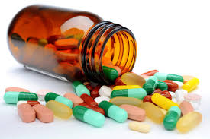
Poll based on Previous Lecture
Cadila Healthcare Limited discovers that while it costs Rs 9.5 per unit to make a medicine in factory, the same is available in the market at Rs 4.5 each.
The breakdown of costs is:
Materials is Rs 3.5 per unit,
Labor is Rs 1.5 per unit,
Fixed expenses is Rs 4.50 and
Shall the product be made in the factory or bought from the outside supplier?
Make the product in factory
Buy the product from outside supplier
Notes:
Make

Slide 3
Learning Outcomes
Comprehend the importance of standard costing and variance analysis in businesses.
Appraise the various material and labor variances arising in businesses.

Slide 4

Opening Case Analysis Starbucks reduces direct cost variances to brew a turnaround
Actual Input costs (material & labour) increased from the set budgeted costs due to:
Recession
Low priced competition from Dunkin’ Donuts and McDonald’s

Slide 5

Opening Case Analysis Starbucks reduces direct cost variances to brew a turnaround
Starbucks removed such variances by:
Cutting down input costs i.e. Material & Labour.
Adopting lean manufacturing
Employed fewer baristas

Slide 6
What Starbucks actually did?
Standard Costing
Establishment of cost standards for activities
Determining the reasons for variances
Variance Analysis
Comparison of actual costs with standard costs
Variances can be ‘favourable’ or ‘unfavourable’
Tool for ‘Cost Control’

Slide 7

A.) Material Costs of ‘Yardley’ soap
Wipro is engaged in manufacturing of special set of ‘Yardley’ soaps.
The order of making 1000 special set of soaps was established to be completed within 8 hours.
The ‘budgeted material cost’ set before the start of manufacturing process is given below:
Budgeted Material Costs
Quantity | Rate | Total Cost
50 Litres of Palm Oil & fat | $140 | $700

Slide 8
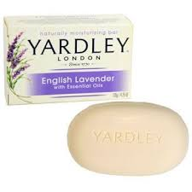
Budgeted & Actual Costs of ‘Yardley’ soap
The ‘Budgeted and Actual Material Costs’ incurred in the manufacturing process is given below:
Material (Budgeted) |  |  | Material (Actual)
Quantity (A) | Rate (B) | Total Cost (A) * (B) | Quantity (A) | Rate (B) | Total Cost (A) * (B)
50 Litres of Palm Oil & fat | $14 | $700 | 60 Litres of Palm Oil & fat | $16 | $960

Slide 9
Material Variances
1.) Material Cost Variance
2.) Material Price Variance
3.) Material Quantity Variance
(SQ*SP) – (AQ*AP)
(SP – AP) * AQ
(SQ – AQ) * SP

Slide 10
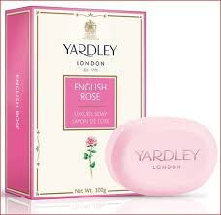
Activity – I
The ‘Budgeted and Actual Material Costs’ incurred in the manufacturing process is given below:
Calculate the following variances of ‘Yardley’ soap:
Material cost variance
Material price variance
Material quantity variance
Material (Budgeted) |  | Material (Actual)
Quantity (A) | Rate (B) | Quantity (A) | Rate (B)
50 Litres of Palm Oil & fat | $14 | 60 Litres of Palm Oil & fat | $16

Slide 11

Poll – II
The standard and actual data of ‘Hindustan Pencil’ related to manufacturing of colored pencil is given below:
Standard material quantity produced = 50 units
Actual material quantity produced = 45 units
Standard material price per unit = Rs. 1
Actual material price per unit = Rs. 0.80
The material price variance (in Rs.) will be:
9 (F)
10 (A)
11 (F)
12 (A)
Notes:
a

Slide 12

B.) Labor Costs of ‘Flying Machine’
Flying machine is engaged in manufacturing of special set of Covid masks.
The company has set the budgeted rate of wages for its workers as $25/hour (to be produced in 10 hours)
During the first month of the new year, Flying machine has difficulty hiring a sufficient number of new employees.
Therefore, it paid more to its existing staff work overtime to complete a number of jobs.
The result is an actual labor rate of $30/hour and took 16 hours to complete the special order.

Slide 13
Labor Variances
1.) Labour Cost Variance
2.) Labour Efficiency Variance
3.) Labour Rate Variance
(ST*SR) – (AT*AR)
(ST – AT) * SR
(SR – AR) * AT

Slide 14

Activity – II
The ‘Budgeted and Actual labor Costs’ incurred in the manufacturing process is given below:
Calculate the following variances of ‘Covid’ masks:
Labor Cost variance
Labor Efficiency variance
Labor Rate variance
Labor (Budgeted) |  | Labor (Actual)
Time | Rate | Time | Rate
10 hours | $25/hour | 16 hours | $30/hour

Slide 15

Poll – III
The standard and actual data of ‘ITC’ related to manufacturing of Classmate notebook is given below:
Standard hours worked = 64.50
Actual hours worked = 61.25
Standard wage rate = Rs. 4.15
Actual wage rate = Rs. 4.25
The ‘labor cost variance’ (in Rs.) will be:
6.13 (A)
13.49 (F)
7.36 (F)
6.13 (F)
Notes:
c

Slide 16

CASE STUDY

Slide 17

Deere & Company (brand name John Deere) is famed for the manufacture and supply of machinery used in agriculture, construction, and forestry, as well as diesel engines and lawn care equipment..

Slide 18
Supply Chain Cost Reduction Challenges:
Deere and Company have a diverse product range, which includes a mix of heavy machinery for the consumer market, and industrial equipment, which is made to order.
Retail activity is extremely seasonal, with the majority of sales occurring between March and July.

Slide 19
The company was replenishing dealers’ inventory weekly, using direct shipment and cross-docking operations from source warehouses located near Deere & Company’s manufacturing facilities.
This operation was proving too costly and too slow
Is there any remedy to reduce cost?

Slide 20
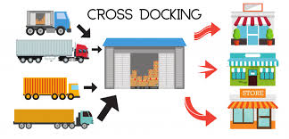
The Path to Cost Reduction
The company undertook a supply chain network-redesign program, resulting in the commissioning of intermediate “merge centers” and optimization of cross-dock terminal locations.
.
Notes:
cross-dock terminal locations.

Slide 21
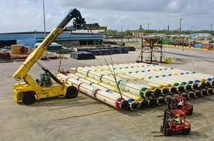
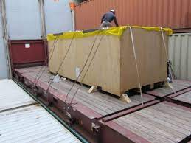
Deere & Company also began consolidating shipments and using break-bulk terminals during the seasonal peak

Slide 22
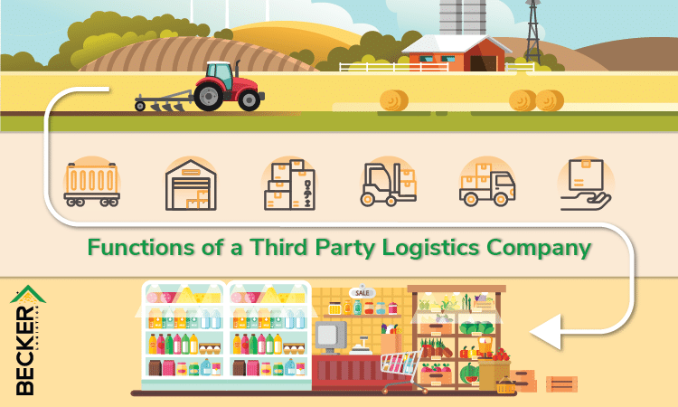
The company also increased its use of third-party logistics providers and effectively created a network that could be optimized tactically at any given point in time

Slide 23

Deere & Company’s supply chain cost-management achievements included an inventory decrease of $1 billion, a significant reduction in customer delivery lead times (from ten days to five or less) and annual transportation cost savings of around 5%.

